Slide 1


TEAM NAME : Syapse_GTB
DOMAIN : Healthcare Track
CATEGORY : AI/ML-powered Web Application
PROJECT TITLE : Project Chronos

Slide 2

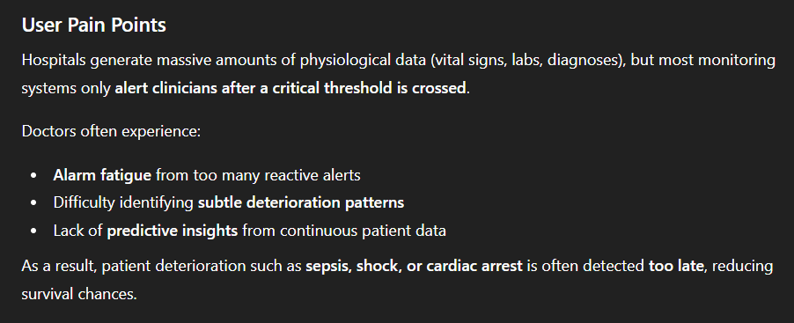
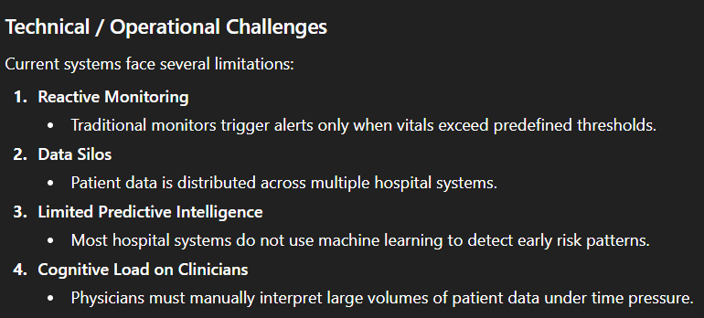
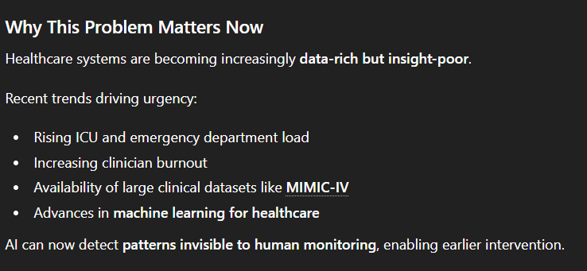
PROBLEM STATEMENT

Slide 3
PROPOSED SOLUTION
Project Chronos is an AI-driven early warning system that analyzes patient vital signs and clinical data to predict clinical deterioration hours before it occurs.
Instead of reacting to crises, the system anticipates risk and alerts clinicians in advance
3. KEY FEATURES
1. Early Risk Prediction
Machine learning models analyze patient vitals to estimate the probability of deterioration.
2. Continuous Monitoring
The system continuously processes incoming patient data and updates risk scores in real time.
3. Intelligent Alerting
Instead of threshold alarms, the system generates predictive alerts based on risk trajectories.
4. Clinical Dashboard
A visualization dashboard displays:
patient risk scores
vitals timeline
predicted deterioration probability
5. Explainable AI
The system highlights which vital signs contributed most to the prediction, improving trust among clinicians.

Slide 4
THE INNOVATION
WHAT MAKES IT UNIQUE/ANTI-BORING?

Slide 5

TECHNICAL DESCRIPTION
TECHNOLOGIES USED: PROGRAMMING LANGUAGES, FRAMEWORKS, LIBRARIES, CLOUD SERVICES, HARDWARE (IF APPLICABLE)
ARCHITECTURE: SYSTEM DESIGN, COMPONENTS, DATA FLOW
PROTOTYPE: SCREENSHOTS OR DEMO IMAGES IF AVAILABLE

Slide 6
IMPACT & BENEFITS
EXPECTED IMPACT ON USERS OR INDUSTRY
KEY BENEFITS (SPEED, COST, SIMPLICITY, ACCESSIBILITY, ACCURACY, ETC.)
SHORT-TERM AND LONG-TERM VALUE
ANY MEASURABLE IMPROVEMENTS, IF APPLICABLE

Slide 7
FEASIBILITY & VIABILITY
TECHNICAL FEASIBILITY
SCALABILITY AND FUTURE ENHANCEMENT SCOPE

Slide 8
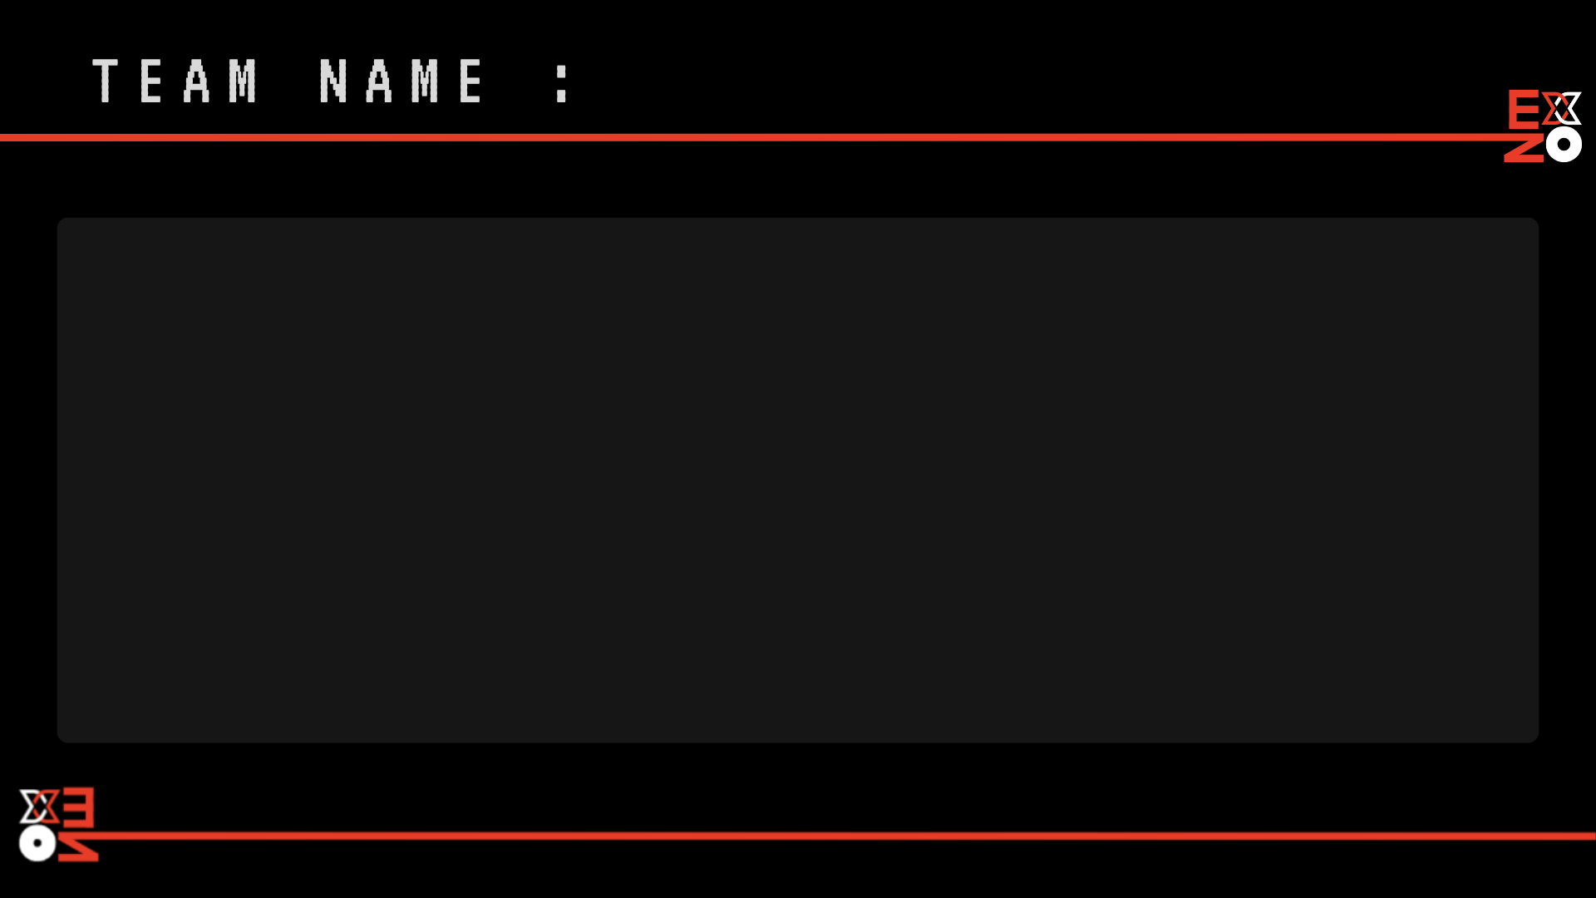
TEAM NAME :
NAME
COLLEGE NAME
CITY
TEAM LEADER
MALE/FEMALE
NAME
COLLEGE NAME
CITY
TEAM LEADER
MALE/FEMALE
NAME
COLLEGE NAME
CITY
TEAM LEADER
MALE/FEMALE
NAME
COLLEGE NAME
CITY
TEAM LEADER
MALE/FEMALE

